Slide 1




Final Project-1 IMDB MOVIE ANALYSIS
By Anusha Gaira
anushagaira@gmail.com

Slide 2

Content
Project description
Approach
Tech Stack Used
Insight
Result

Slide 3
Project Description
The IMDB Movie Analysis project aims to analyze the factor that affects the success of any movie and their higher imdb rating through the IMDB movies dataset. These datasets contain the essential information like director name, budget, genre, rating and actors etc. By exploring and analyzing all this information we aim to understand the impact of imdb score and trends that contribute movie success

Slide 4
Approach
Data cleaning – We have used the downloaded the dataset and used the Microsoft excel for data analysis. Firstly, we searched all the blank data and remove those row in which important data was missing and then replace other blank cell with dash. After that deleted the unnecessary column and duplicate row.
Data Analysis – After cleaning the data we have analysis the data and found out the impact of movie budget, director on the imdb rating. We have manipulated the data and used the descriptive analysis and visualization to answer the question outlined in project.
Report and Data Story – we have created the report and data story after analyzing the data. We used the different visualization and insight to tell the findings about the data.

Slide 5

Tech stack used
Tech stack used in this project is Microsoft Excel 2016
We used the different functions of excel for analysis and statistical distribution like pivot table, charts which provide us the clear understanding of IMDB analysis.

Slide 6
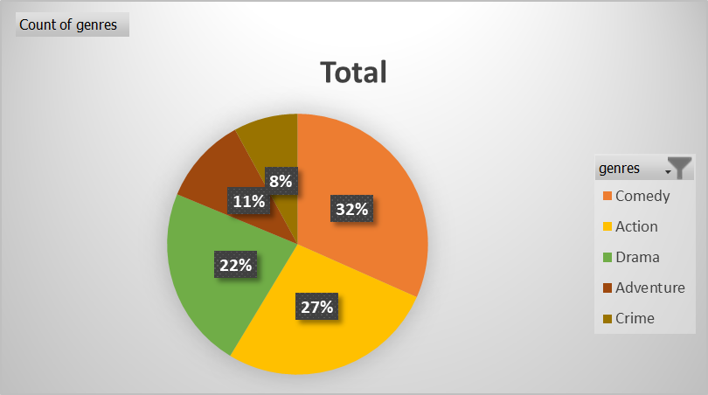
Insight- A. Movie Genre Analysis
We determined the top 5 most common genres of movies and analyzed the distribution of movie genres and their impact on the IMDB score.

Slide 7

Insight – We determined the count of each genre and we find out that the most common genre is comedy ,action, drama and adventures. The total count of comedy genre is 1285 and action is 1096. it gives us insight that mostly director prefer making comedy and action movie because people like these movie most.
Genre | Count of genres | Genres Manipulation
Comedy | 1285 | Average | 240.95
Action | 1096 | Median | 40
Drama | 918 | Mode | 1
Adventure | 438 | Max | 1285
Crime | 323 | Min | 1
Biography | 249 | Var | 155540.682
Horror | 221 | Stddev | 394.386462

Slide 8
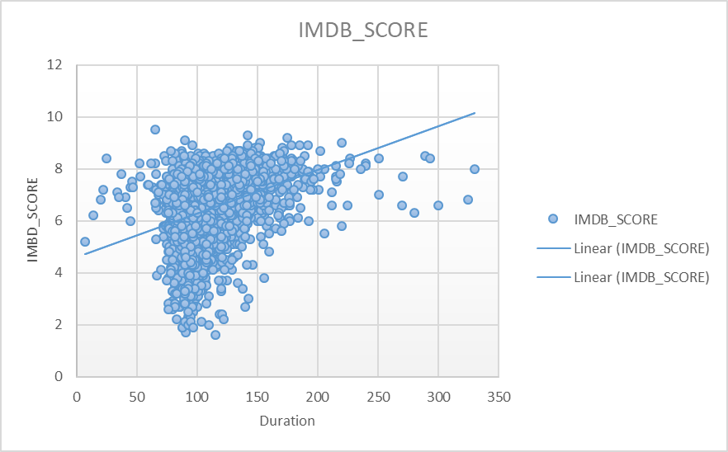
B. Movie Duration Analysis
We analyzed the distribution of movie durations and its impact on the IMDB score. With these result we identified the relationship between movie duration and IMDB score.

Slide 9

Insight – with the help of scatter plot we observed that the co-relation between the imdb score and movie duration is not that strong. It means imdb score not entirely depend on movie duration but if the duration of movie is greater than 240 minute than imdb score between 6 to 8.5.With the help of trend line we can predict that imdb score increases with movie duration and the average duration of movies is 108 minute.
Duration Analysis
Average | 108.0396
Median | 104
STDEV | 22.59696

Slide 10
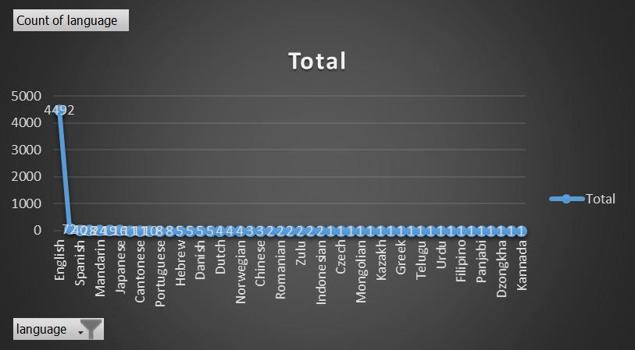
C. Language Analysis:
We determined the most common languages used in movies and analyzed their impact on the IMDB score using descriptive statistics.

Slide 11

TOP 5 LANGUAGE
Language | Count of language
English | 4492
French | 72
Hindi | 28
Mandarin | 24
Spanish | 40
Insight – The most common language used in movies is English followed by French, Hindi and mandarin. Surprisingly mostly prefer watching English movies because count of English movies is way higher than any other language. This gives us insight that if any director making any movie in their religion language they should dub it in English also because people from any continent prefer watching movies in English.

Slide 12
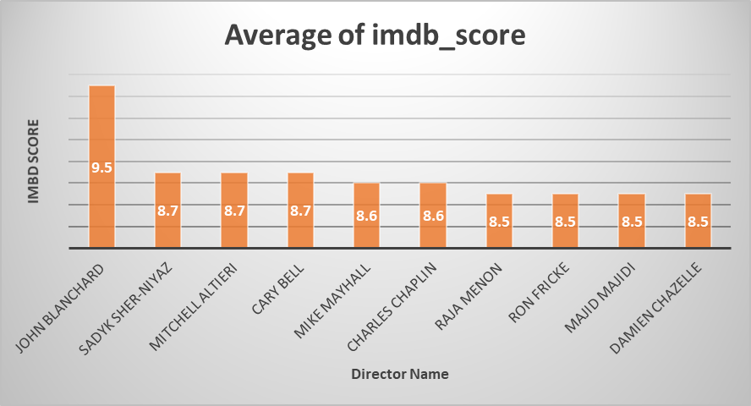
D. Director Analysis
We Identified the top directors based on their average IMDB score and analyzed their contribution to the success of movies using percentile calculations

Slide 13


Top 10 Director | Average of imdb_score
John Blanchard | 9.5
Sadyk Sher-Niyaz | 8.7
Mitchell Altieri | 8.7
Cary Bell | 8.7
Mike Mayhall | 8.6
Charles Chaplin | 8.6
Raja Menon | 8.5
Ron Fricke | 8.5
Majid Majidi | 8.5
Damien Chazelle | 8.5
Insight – Director such as John Blanchard ,sadyak sher, Mitchell and carry bell have directed movies which have highest imdb rating. It shows that they have different vision that influence the audience and leaves their mark on them.

Slide 14

E. Budget Analysis
With the given datasets we analyzed the correlation between movie budgets and gross earnings, and identified the movies with the highest profit margin. We find out that the highest profitable movies of all time are Avatar, Titanic ,Jurassic World and star wars. We determined the correlation between gross and budget which is positive and if we keep budget higher than 2 crore than profit chances are much higher because of their vfx and their set.
Top 5 Movies | Profit
Avatar | 523505847
Titanic | 458672302
Jurassic World | 502177271
Star Wars: Episode IV - A New Hope | 449935665
E.T. the Extra-Terrestrial | 424449459
Correlation between gross and budget | 0.096619736
Max Profit | 523505847 | Avatar

Slide 15
Result
Through this project we gain the insight about the factors affecting movies rating and their profit.
Movie analysis tell us about the most favorite genre that is comedy and action.
These analysis tell us that the average movie duration is 108 minutes and audience prefer English language most.
These analysis will give the insight to producer and director of movies that which type of movies will do good profit in market.
With the help of these analysis they can optimize their movies production strategy and maximize their audience appeal and imdb rating.
Excel and loon videos link - IMDB_Movies.xlsx
Loom video

Slide 16
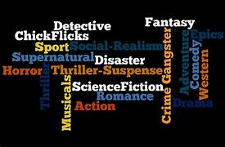
Thank you

